Slide 1
Project Overview
ECSE 211 – Capture the Flag Robot
TEAM 14

Slide 2
The Team
Rahul Amlekar -Project Manager
Daniele Bercovici -Software
William Bouchard -Hardware/testing
Alessandro Commodari -Document Manager
Yan Ren -Software
Asher Wright -Lead Software
Notes:
Write roles of team members

Slide 3
Project Goals
Construct an autonomous robot capable of competing one-on-one with an opponent in a variation of the Capture the Flag game.
Demonstrate the robot in a final demo on Wednesday December 2nd
Document the design process and schedule for creating the robot

Slide 4
Documents
Requirements Document
Capabilities Document
System Document
Constraints Document

Slide 5
Requirements Document
Requirements
People
Scope
Equipment
Locations
Support/TA

Slide 6
Capabilities Document
Everybody has experience with programming and the tools to be used
Roles were assigned according to interest and experience
Some tasks will be shared: software development, testing, document editing, documentation
Availability of group members was determined

Slide 7
System Document
New EV3 Bricks being used
Multiple motor and sensor ports
Easily changeable battery
LejOS Java
Easy to manage multiple ports and motors
Other points
Slow execution of LejOS VM

Slide 8
Constraints Document
Managing time will be challenging
Online communication tools assign work, get feedback, and meeting on the fly
Weekly meetings will be held during DPM lectures
Talk about Gantt chart (from MyCourses)?

Slide 9
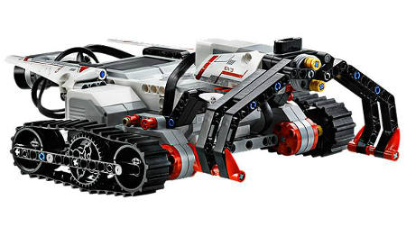
Design ideas
What design ideas do we have? (simple, effective)
Uses one motor to pick up objects, but needs a large claw.
http://static.electronicsweekly.com/gadget-master/wp-content/uploads/sites/4/2013/10/Lego-Mindstorms-EV3-platform.jpg

Slide 10
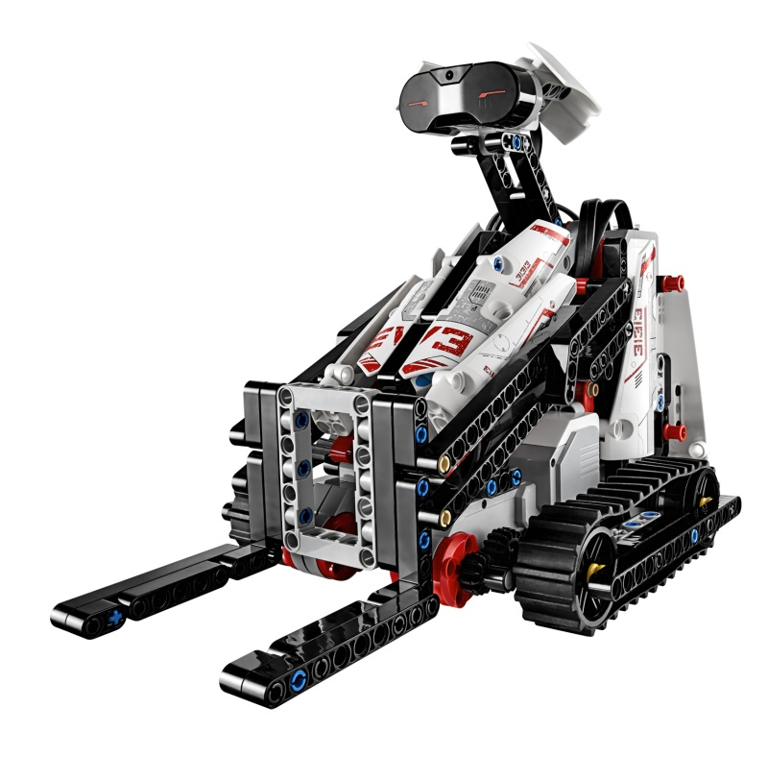
Design ideas
Uses fewer parts, but is harder to pick up the block and
move it accurately.
http://robotsquare.com/wp-content/uploads/2013/07/03_LMS_EV3_BOBB3E.jpg

Slide 11
Design ideas
We will finalize the Mechanical Design by next week (Monday Oct 26).

Slide 12
Agenda – Week 1

Slide 13
Questions?

